Slide 1

Predicting Future Outcomes
An Analysis of Turtle Games
James McPherson
Notes:
Hello, everyone! I'm James, and I'm thrilled to welcome you to our presentation on 'Predicting Future Outcomes: An Analysis of Turtle Games.
Over the next few minutes, we'll dive deep into our analysis, uncovering valuable insights to enhance Turtle Games' sales performance and marketing strategies.

Slide 2

Project Overview
Data-Driven Journey for Turtle Games
Addressing Critical Business Challenges
Global Game Manufacturer and Retailer
Unlocking Insights from Real-World Data
Utilising Python and R for Analysis
Enhancing Sales Performance and Marketing Strategies
Notes:
In this assignment, we're embarking on a data-driven journey to address critical challenges faced by Turtle Games, a global game manufacturer and retailer.
We have been tasked with unlocking valuable insights from real-world data using Python and R.
Turtle Games’s primary objective is to enhance their overall sales performance by harnessing customer trends and optimizing marketing strategies. Operating in a diverse market, Turtle Games offers an extensive range of products, from books to video games, and collects data from both sales transactions and customer reviews.
Our analysis encompasses data exploration, visualization, and statistical modeling to extract actionable insights. Our mission is to equip Turtle Games with the knowledge needed to drive growth and thrive in the competitive gaming industry. So, let's dive into the fascinating world of data analysis and discover the insights that will shape Turtle Games' future success!

Slide 3

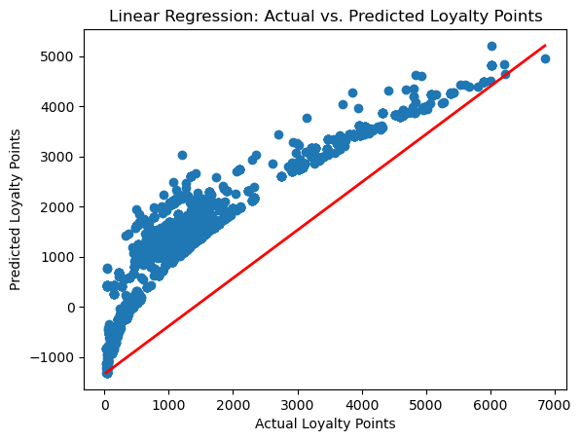
Section 1: Making Predictions with Regression
Linear Regression Analysis: Examining Loyalty Points and Key Factors
Investigating Age, Remuneration, and Spending Score
R-squared Value: 0.840 (84% Variability Explained)
Coefficients and Significance:
Age: 11.0607 (p-value < 0.001)
Remuneration (k£): 34.0084 (p-value < 0.001)
Spending Score (1-100): 34.1832 (p-value < 0.001)
Model Significance: F-statistic: 3491 (p-value < 0.001)
Regression Plot: Visualizing Loyalty Points and Predictions
Notes:
In our analysis, we've harnessed the power of linear regression to delve into the relationships between loyalty points and key demographic and behavioral factors. These factors include age, remuneration in thousands of pounds, and spending score on a scale of 1 to 100.
The results, summarized in the figure, reveal a fascinating story. Our model boasts an impressive R-squared value of 0.840, meaning that approximately 84% of the variability in loyalty points can be explained by these variables.
Age, with its positive coefficient of 11.0607, tells us that for each year increase in age, loyalty points increase by around 11.06 points on average.
Remuneration shows a similar trend, with a positive coefficient of 34.0084 , implying that higher income corresponds to more loyalty points. Spending score, with a coefficient of 34.1832 underscores the connection between higher scores and more loyalty points. The overall model is statistically significant, meaning our findings are rock-solid.
The regression plot visually confirms the positive relationship between these factors and loyalty points. These insights are invaluable for refining our marketing strategies, targeting individuals with higher income and spending scores, and ultimately, boosting our loyalty program's effectiveness to enhance sales performance.

Slide 4
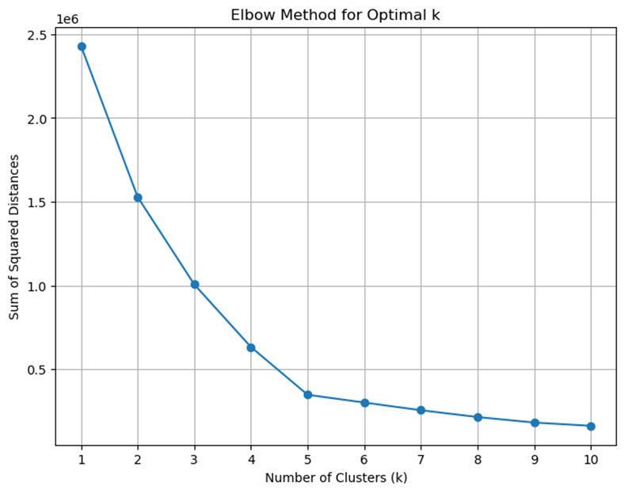
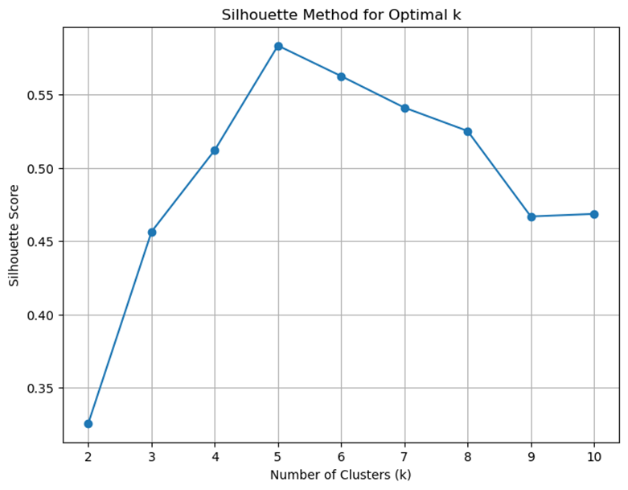
Section 2: Making Predictions with Clustering
Clustering for Customer Segmentation
Focus on Salary and Spending Score
Elbow Method for Optimal Cluster Determination
Sum of Squared Distances (Inertia) for k = 1 to 10
Elbow Point Identified at k=5
Silhouette Method for Quality Assessment
Silhouette Scores from k = 2 to 10
Peak at k=5 (Silhouette Score: 0.583)
Optimal Number of Clusters: k=5
Notes:
In this phase, we explore clustering to optimize marketing strategies based on salary and spending score. We first used the Elbow Method, plotting inertia for k values from 1 to 10. At k=5, we found the 'elbow point,' the optimal cluster choice. Then, we turned to the Silhouette Method, computing scores from k=2 to 10. The peak was at k=5, indicating well-defined clusters. Both methods led to the same result: k=5, offering the right balance between separation and complexity

Slide 5
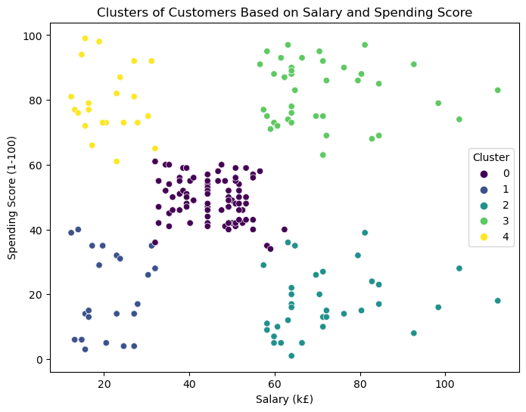
Section 2: Making Predictions with Clustering
Cluster 0 (Moderate Income, Reasonable Spending): 774 Customers
Responsive to Tailored Marketing and Loyalty Programs
Cluster 1 (Low Income, Minimal Spending): 271 Customers
Potential for Targeted Initiatives to Encourage Spending
Cluster 2 (High Income, Low Spending): 330 Customers
Strategies for Unlocking Potential, Possibly Exclusive Offers
Cluster 3 (High Income, High Spending): 356 Customers
Deserving of Premium Products, Personalized Experiences, and Loyalty Programs
Cluster 4 (Low Income, High Spending): 269 Customers
Unique Preferences for Enhanced Engagement
Notes:
Our clustering analysis unveils key insights into distinct customer segments based on salary and spending score.
Cluster 0, with 774 customers, responds well to tailored marketing and loyalty programs.
Cluster 1, 271 customers, may benefit from targeted initiatives.
Cluster 2, 330 customers, with 'High Income' but 'Low Spending,' suggests potential for exclusive offers.
Cluster 3, 356 customers, 'High Income' and 'High Spending,' deserves premium treatment.
Cluster 4, 269 customers, showcase 'Low Income' but 'High Spending.' These insights enable refined marketing, better retention, and improved sales performance.

Slide 6
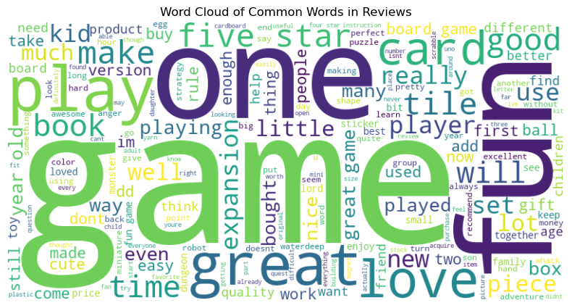
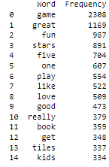
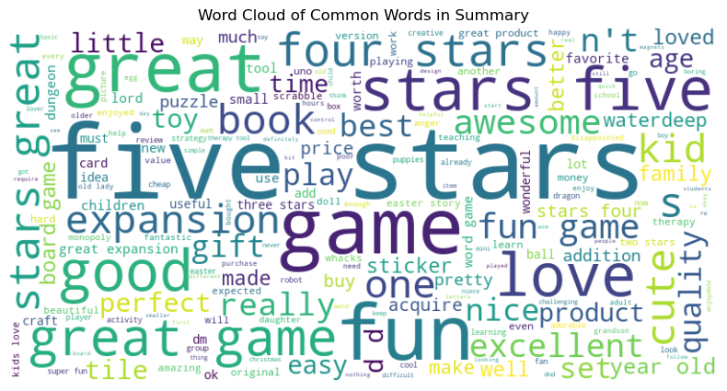
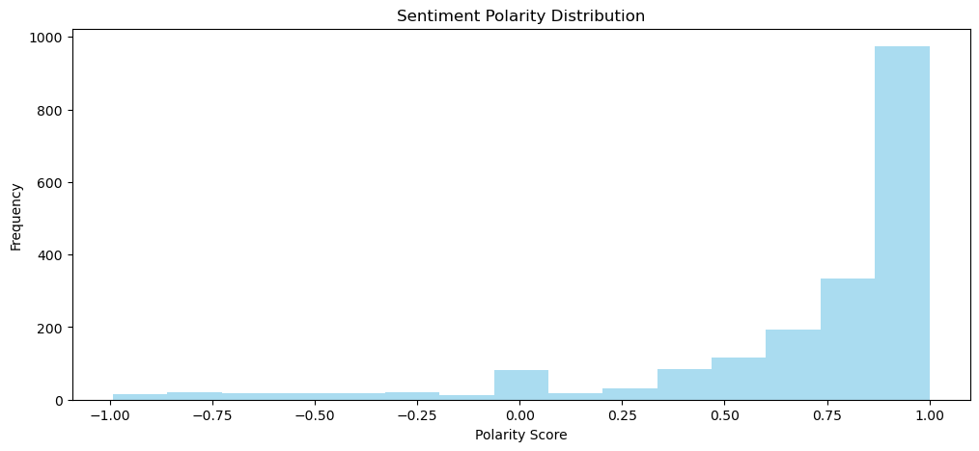
Section 3: Analysing Customer Sentiments with Reviews
Profound Insights from Customer Sentiment Analysis
Leveraging Customer Reviews for Insights
Captivating Word Clouds and Key Themes
Majority Exhibits Positive Sentiment, Peak at 0.875 to 1.0
Insights Guide Marketing Efforts, Satisfaction Enhancement, and Product Refinement
Notes:
Our customer sentiment analysis is a treasure trove of insights that can profoundly shape Turtle Games' marketing strategies. To derive these insights, we embarked on a journey through customer reviews. Through captivating word clouds and visual representations, we illuminated frequently occurring themes. Additionally, we condensed customer sentiment by spotlighting the top 15 frequently used words in the table shown. These words shed light on critical themes and topics deeply resonating with our customers.
But that's not all; we also explored the sentiment polarity distribution of these reviews using a histogram, and what we found was intriguing. Most reviews exhibited positive sentiment, with a notable peak in the polarity score around 0.875 to 1.0. This distribution underscores the importance of catering to a diverse range of customer opinions and experiences.
Our analysis didn't stop there; we extracted the top 20 positive and negative reviews, encapsulating a spectrum of customer experiences. Positive reviews often sang praises about product quality and top-notch customer service, while negative reviews pointed out areas like product bugs and slow support, indicating room for improvement.
In conclusion, our sentiment analysis serves as a guiding light for Turtle Games' marketing efforts. Insights from commonly used words and sentiment polarity, along with the actionable guidance offered by top reviews, empower data-driven decisions and elevate our marketing campaigns

Slide 7
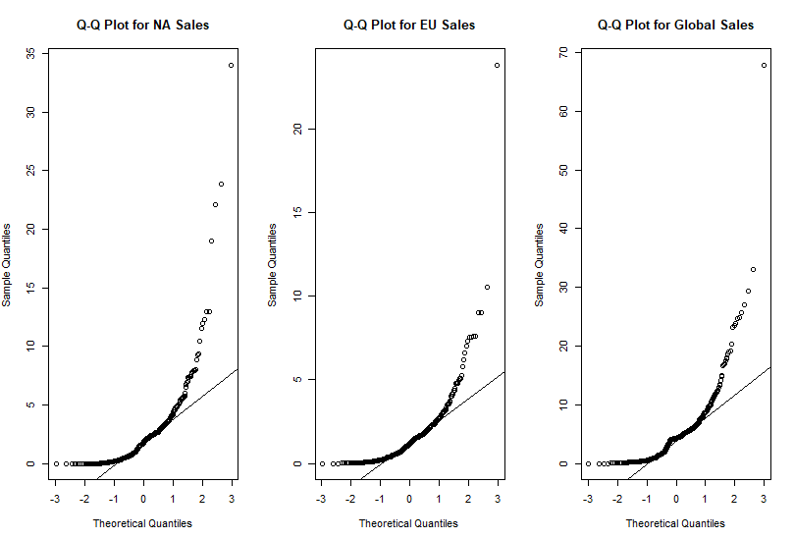
Section 4: Visualising data to gather insights
Data Analysis Using R
Streamlining the Dataset by Removing Redundant Columns
Focusing on Key Variables for a Relevant Exploration
Facilitating Identification of Regional Trends, Platform Preferences, and Outliers
Clear Visual Insights Into Sales Performance
Identifying Regional Gaming Platform Preferences
Enabling Data-Driven Decisions for Marketing and Distribution Strategies
Capitalizing on Trends and Pinpointing Growth Opportunities
Notes:
This slide encompasses our data analysis using R, a pivotal phase in our journey.
We streamlined the the dataset by removing redundant columns, including Ranking, Year, Genre, and Publisher. This focused approach ensures a more concise and relevant exploration of sales data.
Our next step was to create the plots shown in the report provided. These visual representations provide insights into sales data, making it easier to identify regional trends, platform preferences, and outliers.
These plots are incredibly valuable for the business as they offer clear visual insights into sales performance. Ultimately, they enable data-driven decisions that optimize marketing and distribution strategies, capitalize on trends, and pinpoint opportunities for growth.
We followed this up with a Q-Q Plot Analysis: To visually assess the normality of the sales data for North America, Europe , and Global regions,. These plots provide strong visual evidence that the sales data for Turtle Games does not follow a normal distribution. The pronounced curvature in these plots suggests the presence of outliers with exceptionally high sales values.
Understanding these deviations from normality is crucial for selecting appropriate statistical methods and addressing potential outliers in future analyses and decision-making processes. This insight equips Turtle Games with valuable knowledge for refining strategies and enhancing sales performance.

Slide 8
Section 4: Visualising data to gather insights
Normality Assessment: All three sales columns (NA Sales, EU Sales, Global Sales) exhibit non-normal distributions with low p-values (< 2.2e-16) from Shapiro-Wilk tests.
Skewness and Kurtosis: Right-skewed distributions (skewness ≈ 4) indicate concentration at lower sales values with heavy tails (kurtosis ≈ 30-41), suggesting outliers.
Correlation Analysis: Strong positive correlations among sales columns: NA Sales with EU Sales (0.706) and Global Sales (0.935), EU Sales with Global Sales (0.878).
Non-Normal Distributions: Sales data characterized by non-normality, skewness, and heavy tails.
Marketing Insights: Interregional correlations offer marketing strategy opportunities.
Addressing Outliers: Crucial for accurate analysis and informed decisions.
Tailored Strategies: Understand data characteristics for region-specific strategies.
Notes:
Our analysis confirmed that Turtle Games' sales data deviates significantly from normality, as indicated by extremely low p-values in Shapiro-Wilk tests for all three sales columns: NA Sales, EU Sales, and Global Sales.
Skewness and kurtosis metrics revealed right-skewed distributions with skewness values around 4, indicating data concentration toward lower sales values and long tails of higher sales. High kurtosis values (around 30 to 41) suggest heavy-tailed distributions, implying the presence of outliers and potential for extreme sales values.
Correlation analysis unveiled strong positive correlations among the sales columns, with NA Sales showing robust positive associations with EU Sales and Global Sales, with values of 0.706 and 0.936 respectively. EU Sales and Global Sales exhibited a strong positive correlation of 0.878, highlighting interdependencies among regions.
In summary, Turtle Games' sales data lacks normality and exhibits right-skewness and heavy tails. This unique data profile presents opportunities for leveraging regional interdependencies in marketing and distribution strategies. Addressing outliers is essential for accurate analyses and informed business decisions, emphasizing the importance of understanding these data characteristics.

Slide 9
Section 5: Making recommendations to Turtle Games
Simple Linear Regression Model:
Statistically Significant: Intercept and NA Sales coefficient (p-value < 0.001).
High Explained Variability: R-squared value of 0.8741 (87.41%).
Reliable Prediction: Tool for predicting Global Sales based on NA Sales.
Correlation Analysis:
Strong Positive Correlations: NA Sales (0.7055) and EU Sales (0.9349) with Global Sales.
Interconnected Regions: Success in one region benefits others.
Multiple Linear Regression Model:
Significant Coefficients: NA Sales and EU Sales (p-value < 0.001).
Enhanced Explained Variability: R-squared value of 0.9687 (96.87%).
Robust Prediction Tool: Forecasts Global Sales based on both regions.
Predictions for Business Planning:
Scenario Planning: Anticipate sales scenarios.
Resource Allocation: Allocate resources effectively.
Risk Mitigation: Proactive risk management and growth identification.
Notes:
This slide summarizes our key recommendations based on our data analysis for Turtle Games.
Starting with our Simple Linear Regression Model insights, we found that NA Sales has a significant impact on Global Sales, with both the intercept and NA Sales coefficient being statistically significant (p-value < 0.001). Additionally, the high R-squared value of 0.8741 indicates that approximately 87.41% of Global Sales variability can be explained by NA Sales alone. This makes the model a reliable tool for predicting Global Sales based on NA Sales, which is crucial for sales strategy planning and assessing potential market expansions.
Moving on to our Multiple Linear Regression Model, it also yielded significant insights. Both NA Sales and EU Sales coefficients are highly significant (p-value < 0.001), indicating significant impacts on Global Sales. The model exhibits an even higher R-squared value of 0.9687, signifying that approximately 96.87% of Global Sales variability can be explained by both NA and EU Sales combined. This enhances prediction accuracy and makes it a robust tool for forecasting Global Sales in response to changes in both regions.
Finally, we emphasized how these models can be used for business planning. Turtle Games can utilize predictions for scenario planning, resource allocation, and risk mitigation. These tools empower the business to make informed decisions and identify high-potential growth scenarios.

Slide 10
Recommendation Summary
Recommendations | How to Measure Success
Implement cross-regional marketing strategy | Track increased sales in multiple regions
Address outliers in sales data | Observe reduced variability and skewedness
Continuously refine regression models | Monitor improved prediction accuracy
Explore market expansion opportunities | Measure sales growth in new regions/markets
Leverage insights from sentiment analysis | Track customer satisfaction and loyalty improvements
Optimise marketing and distribution | Observe increased sales efficiency and revenue
Notes:
In summary, we have several key recommendations for Turtle Games to boost their sales performance.
1. Cross-Region Marketing and Sales Strategy:
"To maximize sales, we recommend implementing a cross-region marketing and sales strategy. This means using the success in one region as a catalyst for growth in others. By coordinating efforts across regions, you can optimize overall sales."
2. Outlier Management:
"Addressing outliers is crucial for accurate predictions. Carefully analyze and manage outliers, especially those with exceptionally high sales values. This will prevent them from distorting your sales forecasts and overall business strategies."
3. Model Improvement:
"Continuously refine your regression models considering the non-normal distribution and heavy-tailed data. Explore non-linear models or transformations that can enhance accuracy and provide more reliable predictions."
4. Market Expansion:
"Explore opportunities for market expansion in regions with substantial sales potential, such as North America. Consider implementing targeted advertising or offering localized game offerings to tap into these markets."
5. Product Performance Assessment:
"Assess the performance of individual products within your portfolio. Identify high-performing products and consider retiring underperforming ones. This will help you allocate resources more effectively."
6. Customer Segmentation:
"Utilize the clustering analysis to tailor marketing strategies based on salary and spending score. Develop personalized recommendations and loyalty programs for different customer segments to enhance engagement."
7. Customer Sentiment Integration:
"Incorporate customer sentiment analysis findings into your product development and marketing strategies. Address product issues mentioned in negative reviews and emphasize positive aspects in your marketing materials."
8. Regional Focus:
"Leverage insights from regression and correlation analyses to allocate resources effectively. Focus your marketing efforts on regions with strong correlations and growth potential to maximize sales."
Finally. Scenario Planning:
"Use multiple regression model predictions for scenario planning. Anticipate the impact of specific sales scenarios to make informed decisions and allocate resources strategically."
Closing:
"In conclusion, these recommendations provide a solid foundation for evidence-based decision-making at Turtle Games. By implementing these strategies, you can optimize sales, enhance customer satisfaction, and thrive in the dynamic gaming industry. Thank you for listening."

Slide 11
Further Exploration
Specific Factors Analysis:
Game Genres, Platforms, Marketing Campaigns.
Deeper Insights into Sales Impact.
Temporal Aspect Investigation:
Trends Over Time.
Adaptive Strategies Based on Temporal Patterns.
Notes:
To finish off, we have this slide which highlights areas for further exploration in our analysis.
We can delve deeper into the impact of specific factors like game genres, platforms, or marketing campaigns on sales to gain more insights.
Additionally, investigating temporal aspects such as trends over time can help adapt strategies accordingly.
In conclusion, the findings from this analysis serve as a foundation for evidence-based decision-making at Turtle Games. By leveraging regional relationships, addressing outliers, and refining predictive models, the business can optimize sales strategies and seize growth opportunities in the dynamic gaming industry.
Thank you all for your attention and for joining us in this exploration and analysis of Turtle Games.

